Slide 1

Guru Gobind Singh College of Engineering and Research Center, Nashik.
Department of Computer Engineering
Academic Year: 2023-24
Final Year Project Work
Review 5
Date : 21 Nov 2023
Group ID | G - 2
Project Title | Civic Complaints Registration Application for Citizens of Rural/Urban Areas.
Team Members | 1. Tejas Bhandare
 | 2. Ishan Ahirrao
 | 3. Rohit Bava
Guide Name | Prof. S. G. Shukla

Slide 2

Presentation Outline :
Introduction :
Problem Statement
Motivation
Objectives
Scope
Software & Hardware Requirements
Literature Survey
Feasibility Study
Requirement Analysis
System Architecture
UML Diagrams : Class, Object, Use Case, Data Flow, Sequence, Activity
Conclusion.
Guru Gobind Singh College of Engineering, Nashik

Slide 3
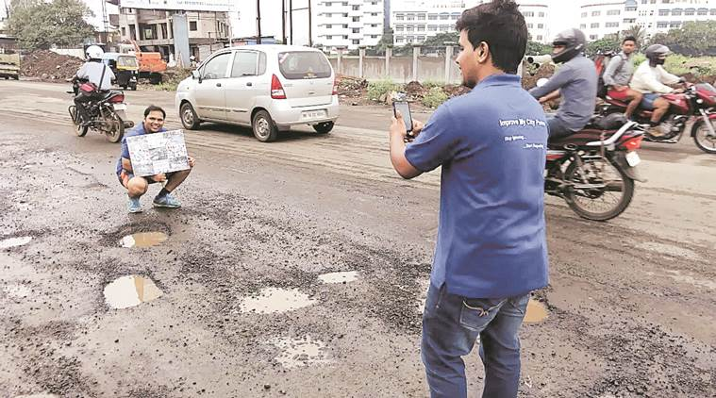
1. Problem Statement
Civic Complaint Registration Application for Urban/Rural Areas.
The Civic Complaint Registration Application for Urban/Rural Areas is a solution to address complaints related to waste material, streetlight issues, sewer line blockages, road repairs, and more in both urban and rural regions.
Guru Gobind Singh College of Engineering, Nashik

Slide 4
2. Motivation
Addressing Civic Needs: A Civil Complaint Registration Application that directly addresses civic needs by resolving issues in both rural and urban areas.
Positive Impact: It promises to have a positive and lasting impact on both rural and urban areas, improving the quality of life for citizens and enhancing the efficiency of municipal services.
Community Engagement: By facilitating citizen engagement and feedback, the project fosters a sense of community involvement and ownership.
Guru Gobind Singh College of Engineering, Nashik

Slide 5
3. Objective
To enhance civic engagement
Improve administrative efficiency
Contribute to the overall betterment of communities
Streamline Complaint Reporting
Automated Complaint Evaluation
Priority Assignment
Guru Gobind Singh College of Engineering, Nashik

Slide 6
4. Scope
Data-Driven Decision Making: Collect, Analyze, and Visualize complaint data to provide local authorities with valuable insights for better resource allocation, urban planning, and evidence-based decision-making.
Transparency and Accountability: Transparency in local governance by providing real-time updates to citizens on the status of their complaints, ensuring they remain informed throughout the resolution process.
Collaboration with Local Authorities: Collaborate closely with municipal authorities,.
User Adoption and Community Impact: With a focus on reaching underserved areas, to empower citizens and create a positive impact on their communities.
Guru Gobind Singh College of Engineering, Nashik

Slide 7
Software- Hardware requirement
Resources: The requirement of the resources for designing and developing the proposed system are as mentioned below:
Hardware / Software Requirement
Laptop/PC with minimum hardware and software versions(2GB Ram, 256SSD & OS: Windows 7 and above).
Visual Studio Code, Flutter, Dart.
3G/4G/5G Smartphone.
Guru Gobind Singh College of Engineering, Nashik

Slide 8

5. Literature Survey
Name of paper | Authors | Working | Merits | Demerits
Civic Complaint Application under Smart City Project | Satish Kumar Prasad Ritesh Patil Sagar Beldare Prof. Anita Shinde | Web application to reporting civic issues via mobile | Used tools and technologies to replace conventional manual complaint registration. | Manual Entry of Civic Issue details.
Guru Gobind Singh College of Engineering, Nashik

Slide 9
5. Literature Survey
Name of paper | Authors | Working | Merits | Demerits
Adversarial Adaptation of Scene Graph Models for Understanding Civic Issues | Shanu Kumar Anjali Singh Mohit Jain | Used Scene Graph Model to address Civic issues via Image Processing. | Complete representation of all objects and relationship.
Guru Gobind Singh College of Engineering, Nashik

Slide 10
5. Literature Survey
Name of paper | Authors | Working | Merits | Demerits
A Survey of Scene Graph: Generation and Application | Pengfei Xu Xiaojun Chang Ling Guo Poyao Huang Xiaojiang Chen Alexander G. Hauptmann | Scene graph generation methods are proposed to build a more complete scene graph by a variety of network models, feature extraction methods, and even by introducing the prior knowledge. | More accurate object detection in Images.
Guru Gobind Singh College of Engineering, Nashik

Slide 11
5. Literature Survey
Name of paper | Authors | Working | Merits | Demerits
Civic Complaint Reporting Using Image Processing. | Anjaly Antony Minla K.S | Online Web Application that let Citizens report there problems with infrastructure in their City to relevant authority. | Used tools and technologies to replace conventional manual complaint registration. | Citizens Voting based priority assignment for complaints.
Guru Gobind Singh College of Engineering, Nashik

Slide 12
5. Literature Survey
Name of paper | Authors | Working | Merits | Demerits
Smart Civic Issue Reporting System. | Dnyanesh Walwadkar Saurav Yadav | Research on using social middleware for Civic issue reporting | Leveraging Civic tech as well as enhancing its capabilities to foster the engagement of people.
Guru Gobind Singh College of Engineering, Nashik

Slide 13
Feasibility
The system will leverage automation technology, including Machine Learning (ML), Data Science, Computer Vision and Image Processing.
Feasibility Aspects:
Technical Feasibility :
Technology stack
Image processing capabilities
Integration with geographic information systems (GIS)
Economic Feasibility :
Initial Investment : Expenses related to software development, hardware, licensing, training, and any other startup costs.
Operational Costs : Expenses such as server hosting, maintenance, staff salaries, and any third-party services or software licenses.
Operational Feasibility :
Support and Maintenance
Compatibility
Timeframe
Guru Gobind Singh College of Engineering, Nashik

Slide 14
Requirement Analysis:
Datasets :
Municipal corporation’s Geofencing dataset.
Civil complaint Classes dataset.
Local authorities hierarchy dataset.
Historical civil complaints dataset.
Guru Gobind Singh College of Engineering, Nashik

Slide 15
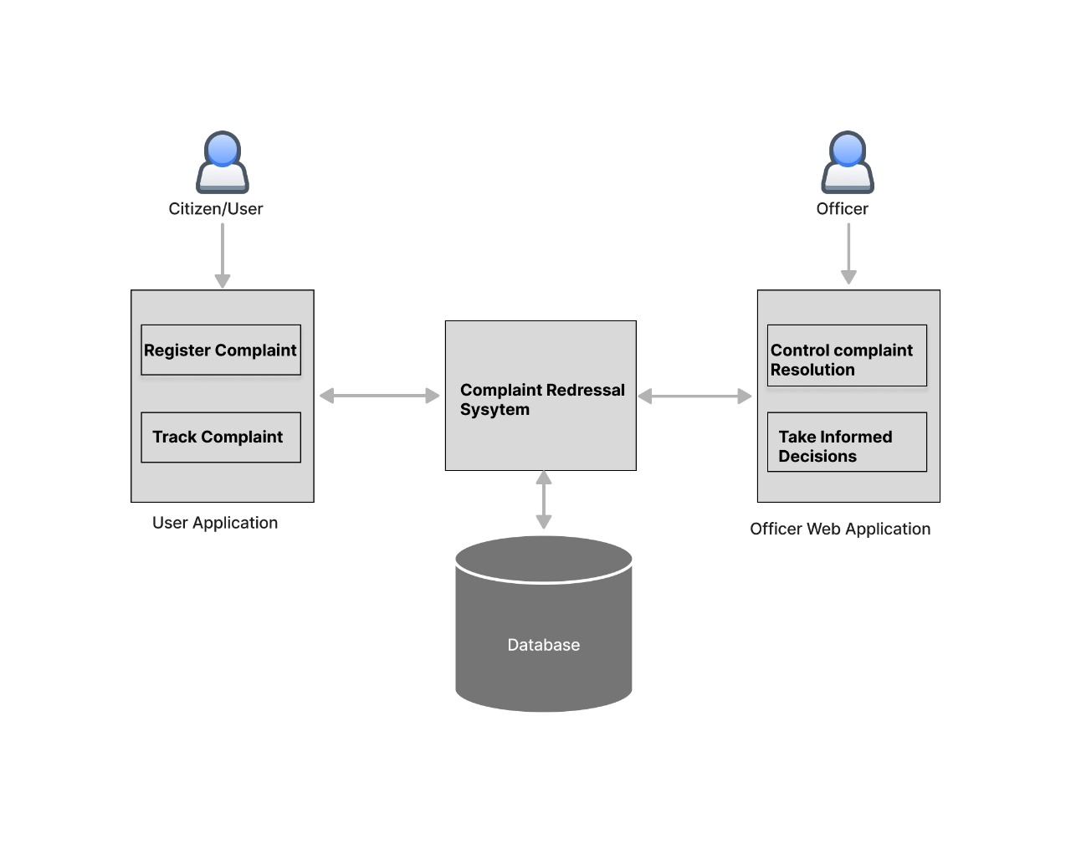
System Architecture:
Guru Gobind Singh College of Engineering, Nashik

Slide 16
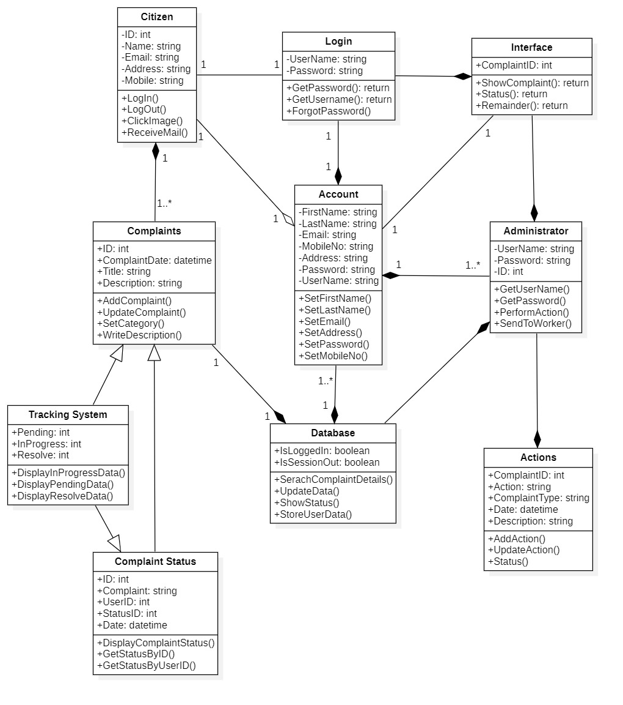
Class Diagram
Guru Gobind Singh College of Engineering, Nashik

Slide 17
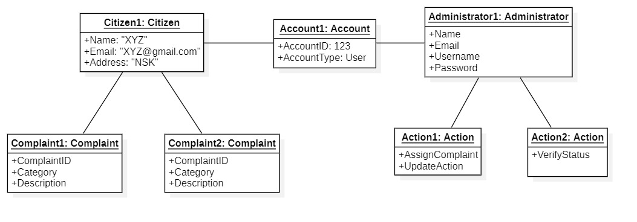
Object Diagram:
Guru Gobind Singh College of Engineering, Nashik

Slide 18
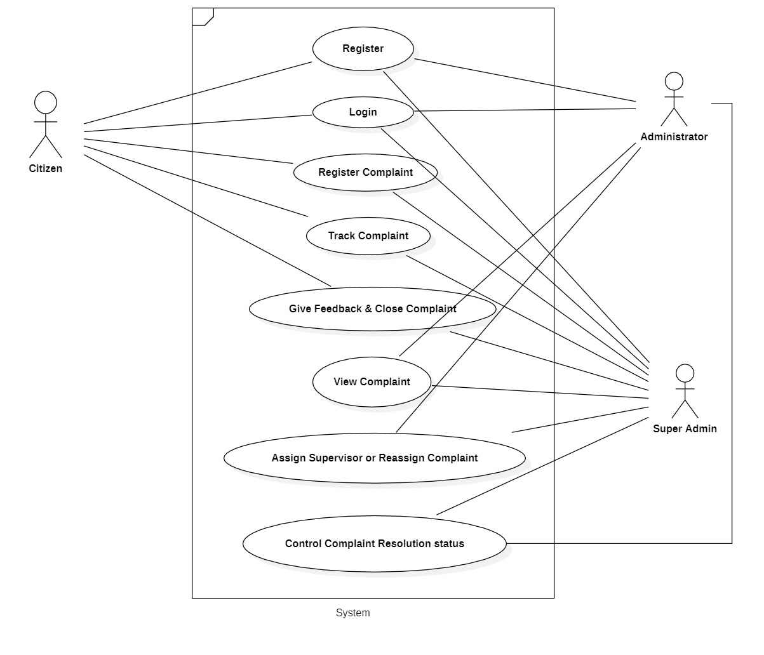
Use Case Diagram:
Guru Gobind Singh College of Engineering, Nashik

Slide 19
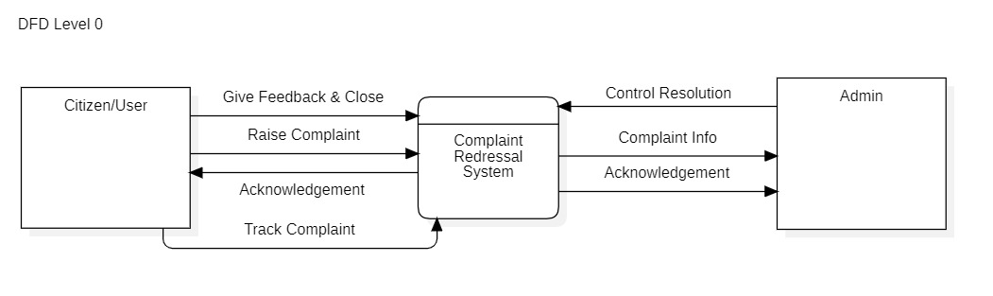
DFD Level 0:
Guru Gobind Singh College of Engineering, Nashik

Slide 20
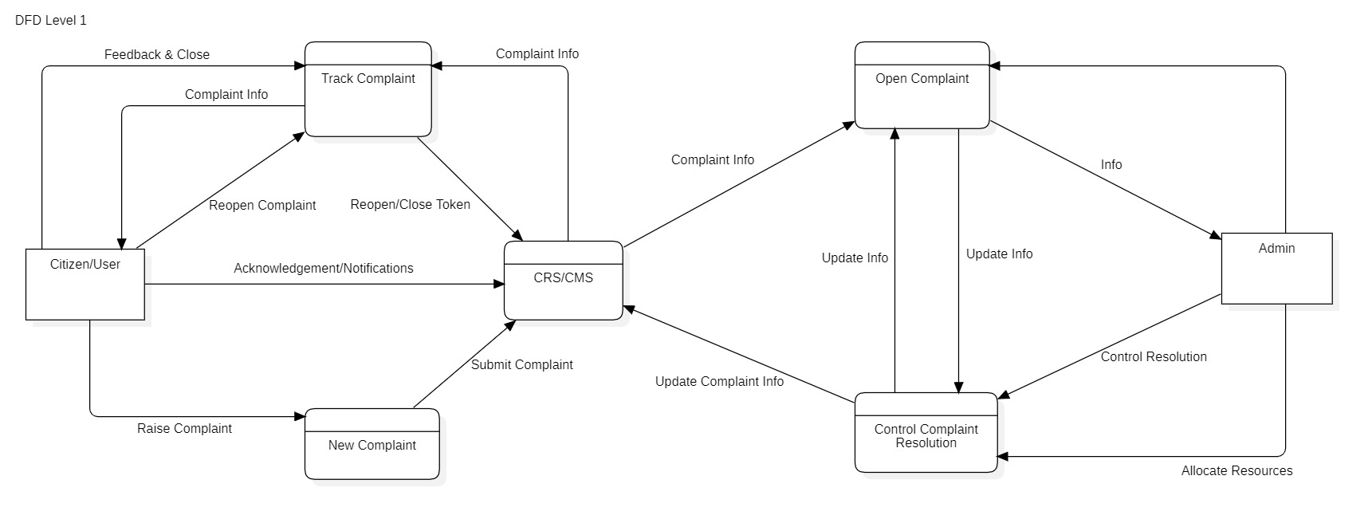
DFD Level 1:
Guru Gobind Singh College of Engineering, Nashik

Slide 21
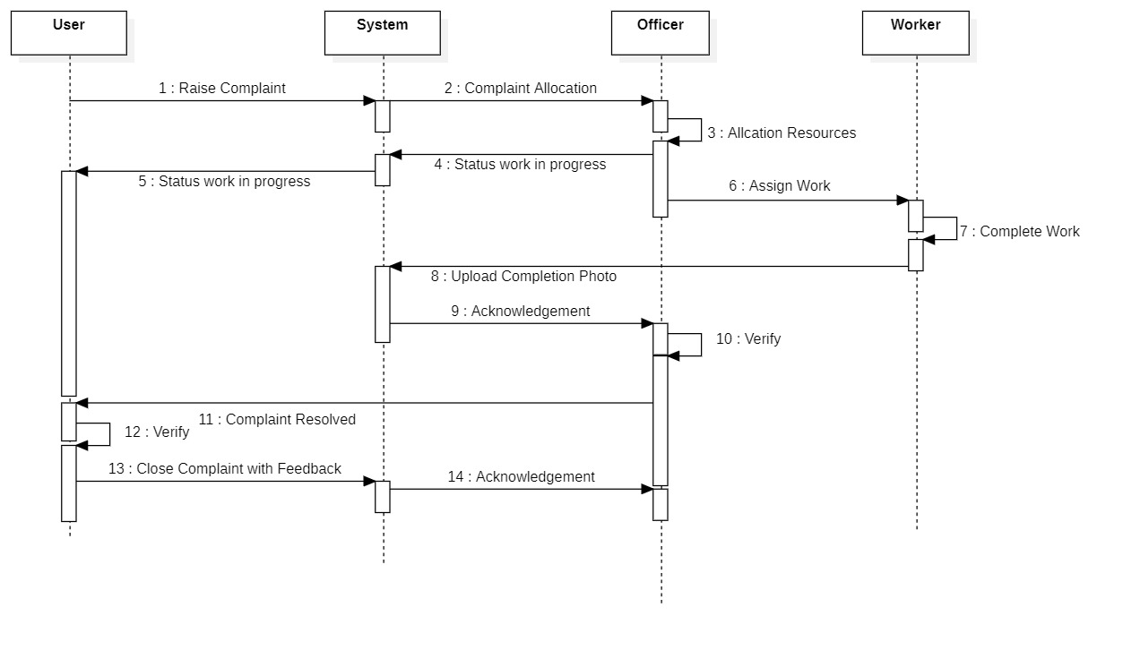
Sequence Diagram :
Guru Gobind Singh College of Engineering, Nashik

Slide 22
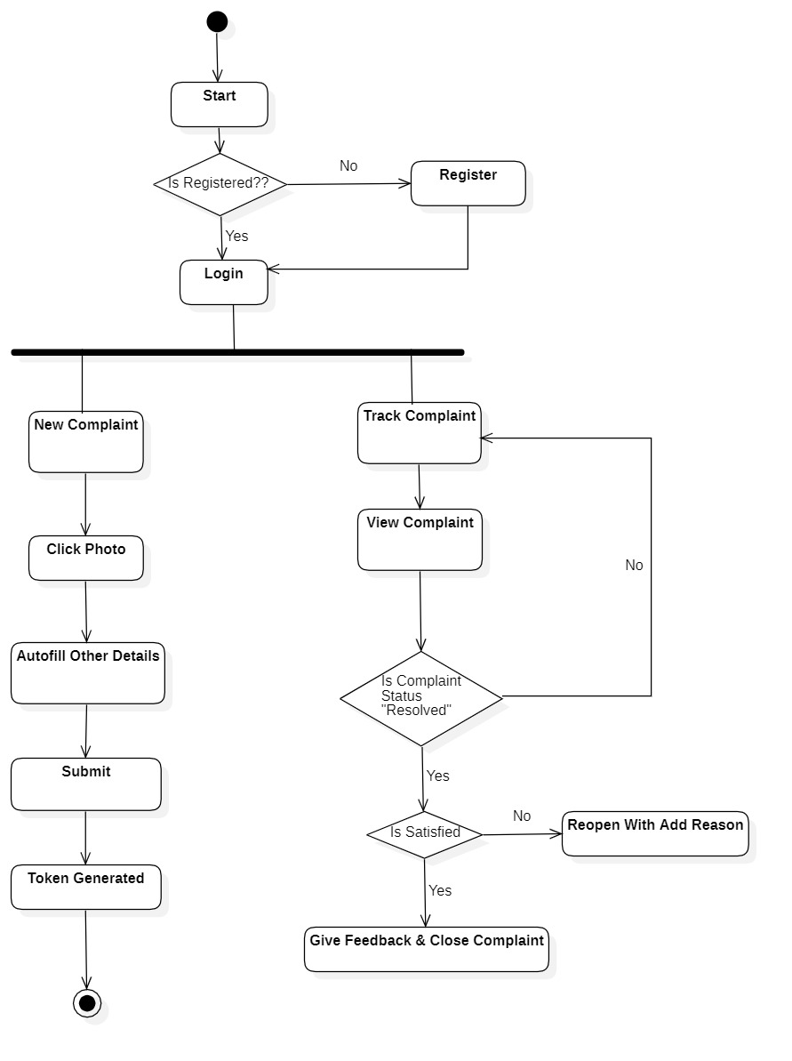
Activity Diagram : User/Citizen
Guru Gobind Singh College of Engineering, Nashik

Slide 23
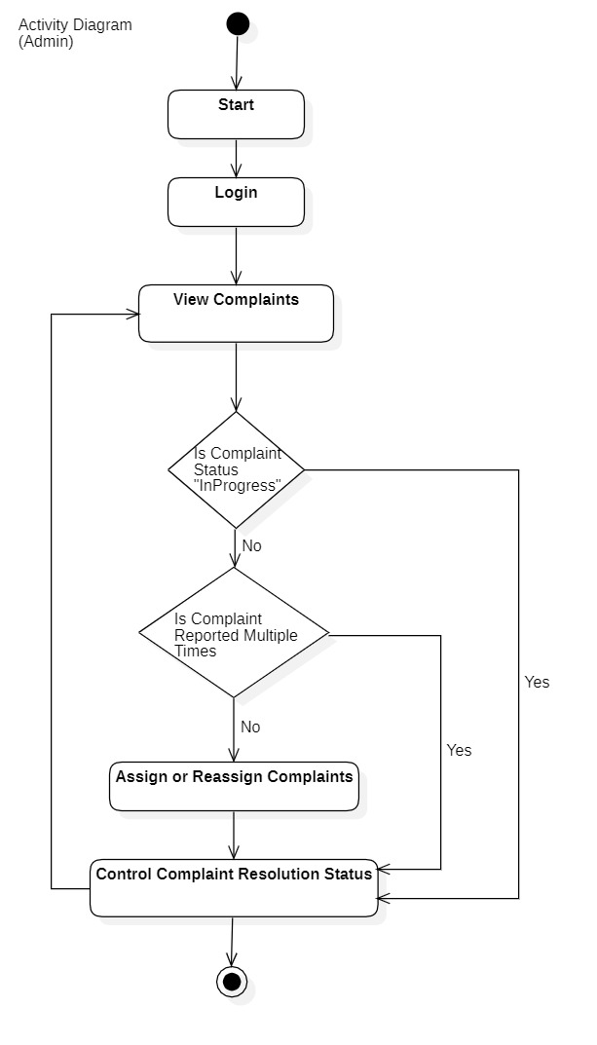
Activity Diagram :Admin
Guru Gobind Singh College of Engineering, Nashik

Slide 24
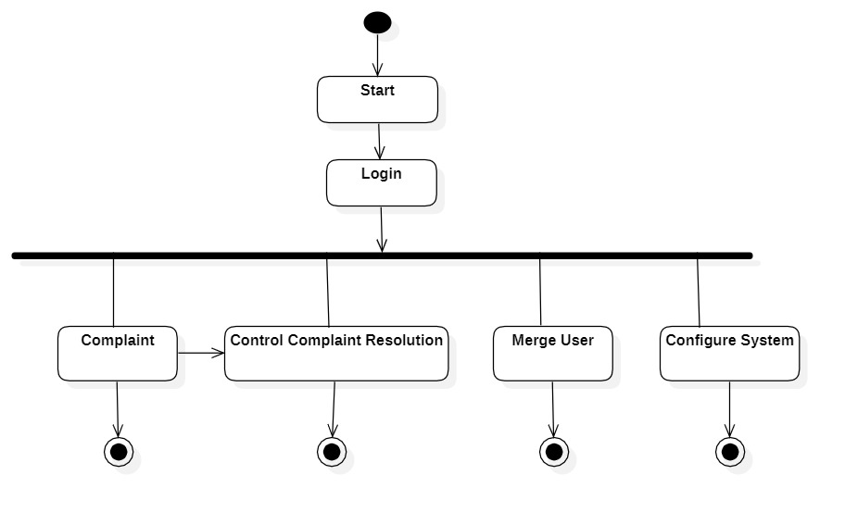
Activity Diagram : Super Admin
Guru Gobind Singh College of Engineering, Nashik

Slide 25
Conclusion
Our proposed "Civic Complaint Registering Application" leverages advanced technology to empower citizens, streamline complaint resolution, and enhance community engagement. It has the potential to revolutionize the way urban and rural areas address critical issues and foster transparency in local governance.
Guru Gobind Singh College of Engineering, Nashik

